Slide 1
SQL Tips & Tricks
Usage Examples for Tally Tables
& the APPLY Operator by Pieter Geerkens
Code (MIT License) &Presentation
Available at: https://github.com/pgeerkens/Presentations
Copyright © 2016 Pieter Geerkens

Slide 2
Contents
Tally Tables:
What are they?
How (not) to Fill Them
Filling Gaps
Indexing Strings
APPLY Operator use w/ table-value constructors:
Description
Unpivoting (aka Folding)
Eliminating CASE in Pivoting

Slide 3
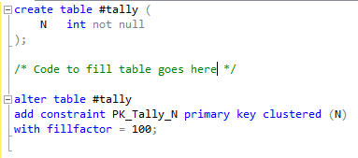
Tally Tables – What are They?
A fully indexed table of numbers, typically from 0 to N-1
Usually pre-filled to a well-known number of rows
Can be efficiently generated in CTE if not available as static table – but don’t use a recursive CTE; there is a better way!
Used to replace loops
Schema Definition:

Slide 4
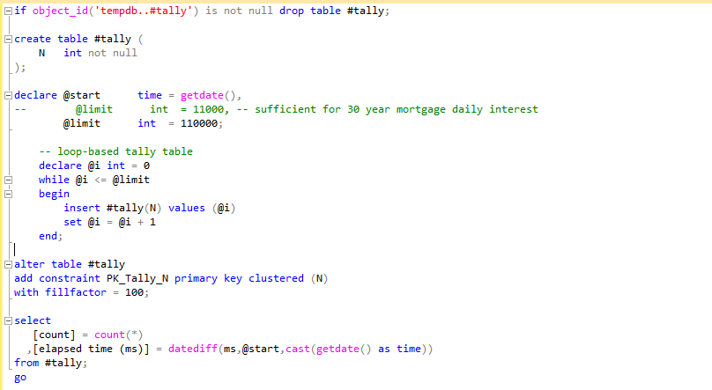
Tally Tables – How not to Fill Them
Notes:
- Best result from several consecutive runs.

Slide 5
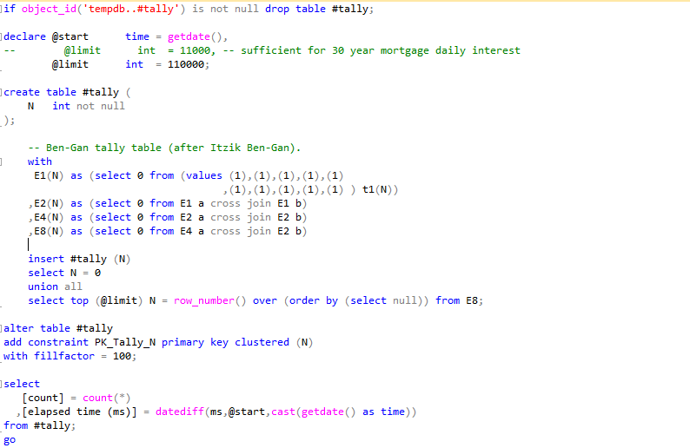
Tally Tables – How to Fill Them
Notes:
Runs ~ 8 times faster than preceding WHILE loop.
Easily extended to a CTE by replacing the line `insert #tally(N)` with `,tally(N) as`.

Slide 6
Tally Tables – Filling Gaps #1
Most common usage of tally tables is to fill gaps:
Fill in days between BeginDate and EndDate in a FiscalPeriod table:
Eg: eases use of a fully normalized (ie sparse) holiday table
Eg: Eases dynamic creation (or periodic filling) of a Days table from a fully normalized FiscalPeriod table
Fill in hours for shifts in a Scheduling table
Replaces looping with WHILE statement with more efficient (and often more readable) mechanism

Slide 7
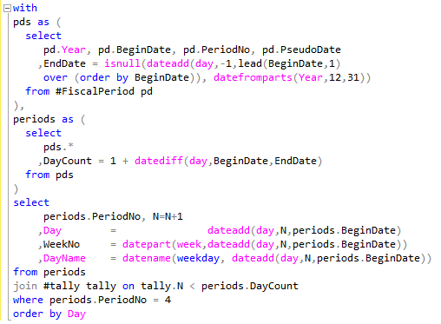
Tally Tables – Filling Gaps #2
Example – 13 week periods ending on 4th/8th/13th/… Sat.:

Slide 8
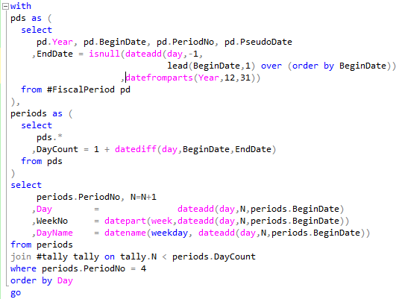
Tally Tables – Filling Gaps #2A
Example – 13 week periods ending on 4th/8th/13th/… Sat.:
Note the use of the windowing function in the pds CTE
Greatly simplify many cases formerly requiring delicate self-joins
Most used:
row_number()
lead()
lag()

Slide 9
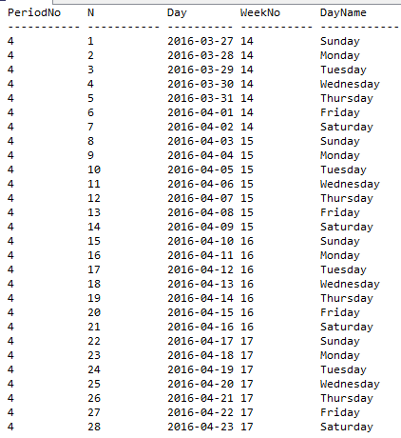
Tally Tables – Filling Gaps #3
Example – 13 week periods ending on 4th/8th/13th/… Sat.:

Slide 10
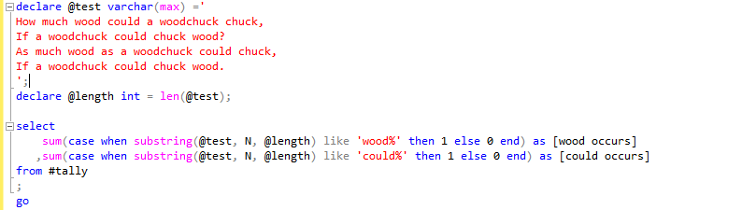
Tally Tables – Indexing Strings
Example – Pattern/Substring Matching in Strings:
Jeff Moden’s Tally-Ho! 8K String Splitter: http://www.sqlservercentral.com/articles/Tally+Table/72993/

Slide 11
APPLY Operator - Description
Not new - Introduced to MS-SQL in SQL Server 2005
Two Flavours: CROSS APPLY and OUTER APPLY
OUTER APPLY resembles a LEFT OUTER JOIN
Join constraints specified using terms in the WHERE clause instead of an ON clause
CROSS APPLY resembles a CROSS JOIN
INNER APPLY equivalent to CROSS APPLY with join constraints specified using terms in the WHERE clause instead of an ON clause
Works much like a JOIN, with additional capability of invoking a table-valued function using columns from previously JOIN-ed tables.
Addition of Table-value constructors in SQL Server 2008 further enhanced APPLY:
APPLY-ed table-value constructors can reference columns of previously JOIN-ed tables:
Simplifies folding (ie un-pivoting)
Enables elimination of many CASE constructs from the SELECT clause

Slide 12
CROSS APPLY Operator – #1
Activity Based Costing (by manufacturing corporation) Credit Sales Journal:
Note:
Looks denormalized – so not appropriate description of storage mechanism
However; a valid stored procedure signature for this transaction type.
Thus an appropriate basis for work
Ways to normalize before writing to Journal tables:
UNPIVOT operator
CASE operators in SELECT clause
APPLY operator

Slide 13
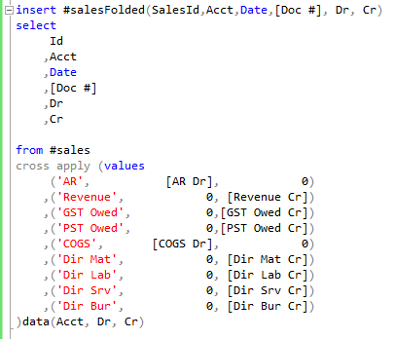
CROSS APPLY Operator – # 2
Uses CROSS APPLY with no constraints
Data-driven formulation eases comprehension
Personal preference for separate Dr and Cr columns; easily adapted to single Amount column, either with or without a Dr_Cr flag

Slide 14
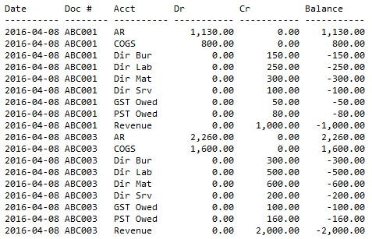
CROSS APPLY Operator – # 3

Slide 15
“INNER” APPLY Operator – #1
What if desire to pivot again, to a summarized journal format?

Slide 16
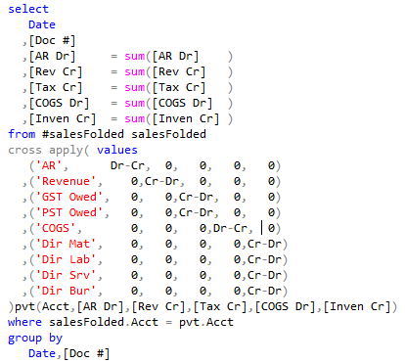
“INNER” APPLY Operator – #2
What if desire to pivot again, to a summarized journal format?

Slide 17

“INNER” APPLY Operator – #2
What if desire to pivot again, to a summarized journal format?

Slide 18
Conclusion
Looked at Tally (or Numbers) tables:
What they are; and their relationship to Day tables
How to fill them efficiently: performance advantage of joins vs WHILE
Used to Fill gaps: days, hours, etc.
Also useful for indexing into index-able data structures, such as strings
Briefly mentioned windowing functions introduced since 2005
Looked at APPLY operator (CROSS, OUTER, & “INNER”)
Even more powerful combined with table-value constructors
Alternative to PIVOT operator
Alternative to UNPIVOT operator
Eliminate CASE operator (and consequent risk of cache-line flushes) in many instances

Slide 19

Questions?

